Slide 1
Biostats Boot Camp – Session 3
Aditya Biswas, Perry Wilson

Slide 2
Today
Discuss hypothesis testing
“Is my observed data sufficiently odd compared to some standard distribution that I can conclude something interesting is going on”?
Provide intuition regarding the math underlying hypothesis testing
And the basic techniques of conducting these tests in R

Slide 3
The Tyranny of the P-Value

Slide 4
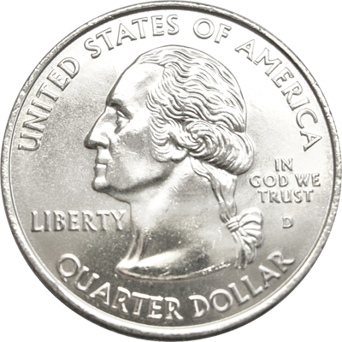
Crowd-sourcing the p-value
I have in my pocket one quarter of a US dollar
It may be a real quarter
It may be a “trick” quarter, with heads on both sides
You can not inspect it
But I will flip it

Slide 5
Raise your hand when you feel relatively confident that the quarter has two heads
Flip | Outcome

Slide 6
Raise your hand when you feel relatively confident that the quarter has two heads
Flip | Outcome
1 | Heads

Slide 7
Raise your hand when you feel relatively confident that the quarter has two heads
Flip | Outcome
1 | Heads
2 | Heads

Slide 8
Raise your hand when you feel relatively confident that the quarter has two heads
Flip | Outcome
1 | Heads
2 | Heads
3 | Heads

Slide 9
Raise your hand when you feel relatively confident that the quarter has two heads
Flip | Outcome
1 | Heads
2 | Heads
3 | Heads
4 | Heads

Slide 10
Raise your hand when you feel relatively confident that the quarter has two heads
Flip | Outcome
1 | Heads
2 | Heads
3 | Heads
4 | Heads
5 | Heads

Slide 11
Raise your hand when you feel relatively confident that the quarter has two heads
Flip | Outcome
1 | Heads
2 | Heads
3 | Heads
4 | Heads
5 | Heads
6 | Heads

Slide 12
Raise your hand when you feel relatively confident that the quarter has two heads
Flip | Outcome
1 | Heads
2 | Heads
3 | Heads
4 | Heads
5 | Heads
6 | Heads
7 | Heads

Slide 13
Raise your hand when you feel relatively confident that the quarter has two heads
Flip | Outcome
1 | Heads
2 | Heads
3 | Heads
4 | Heads
5 | Heads
6 | Heads
7 | Heads
8 | Heads

Slide 14
Raise your hand when you feel relatively confident that the quarter has two heads
Flip | Outcome
1 | Heads
2 | Heads
3 | Heads
4 | Heads
5 | Heads
6 | Heads
7 | Heads
8 | Heads
9 | Heads

Slide 15
Raise your hand when you feel relatively confident that the quarter has two heads
Flip | Outcome
1 | Heads
2 | Heads
3 | Heads
4 | Heads
5 | Heads
6 | Heads
7 | Heads
8 | Heads
9 | Heads
10 | Heads

Slide 16
Raise your hand when you feel relatively confident that the quarter has two heads
Flip | Outcome | Probability Assuming H0
1 | Heads | 0.50
2 | Heads | 0.25
3 | Heads | 0.125
4 | Heads | 0.063
5 | Heads | 0.031
6 | Heads | 0.016
7 | Heads | 0.008
8 | Heads | 0.004
9 | Heads | 0.002
10 | Heads | 0.001

Slide 17
Operationalizing What Just happened
Two hypotheses:
H1: The quarter has two heads
H0: The quarter is an ordinary quarter with a head and a tail
We calculated the probability of what we saw happening given that the H0 was true
This is very close to the definition of a p-value
We use this to make a binary conclusion

Slide 18
Trade-offs for Hypothesis Testing
Often evaluating a fixed, rigid null hypothesis for the way nature works
e.g. these two subpopulations are exactly the same
Rigid null hypotheses allow for tractable mathematics
i.e. the null hypothesis implies a specific, analyzable probability model
Conclusions are easy to communicate
e.g. women experience higher rates of recovery than men under x medication

Slide 19
Pitfalls of the P-value
It give NO sense of clinical importance
It is NOT the chance that the study is a false positive
It gives WAY LESS information than the confidence interval (which is part of our other statistical inference task: estimation)

Slide 20
How Weird Is My Data?
We only get to do our study once, but we can simulate the outcome of our study as many times as we want, assuming the null hypothesis
Then we can look at how weird our observed data is compared to all those hypothetical results.
Very weird == potentially interesting

Slide 21
Alternative Hypotheses
Choice of alternative hypothesis formalizes two things:
What you mean by "weird"
The "direction" you are interested in finding a positive result
One-Sided Tests
Two-Sided Tests

Slide 22
Go to notebook

Slide 23
Choosing the Statistical Test
Looking to Detect | Variable 1 (x) | Variable 2 (y) | Statistical Test | R Function
Statistical Dependence | continuous, normal | continuous, normal | Pearson correlation coefficient | cor.test
 | continuous, non-normal | continuous, non-normal | Spearman correlation coefficient | cor.test
 | Categorical | Categorical | Chi-Squared Test | chisq.test
Differences in Distribution btw Groups | continuous, normal | Binary | Student's t-Test | t.test
 | continuous, non-normal | Binary | Wilcoxon Rank-Sum Test | wilcox.test
 | continuous, normal | 3 or more categories | ANOVA | aov
 | continuous, non-normal | 3 or more categories | Kruskal-Wallis Test | kruskal.test
 | Categorical | Categorical | Chi-Squared Test | chisq.test

Slide 24
Exercise
Create a scatter plot comparing creatinine_max and bicarbonate_min
Are creatinine_max and bicarbonate_min significantly correlated? What correlation statistic should you report?

Slide 25
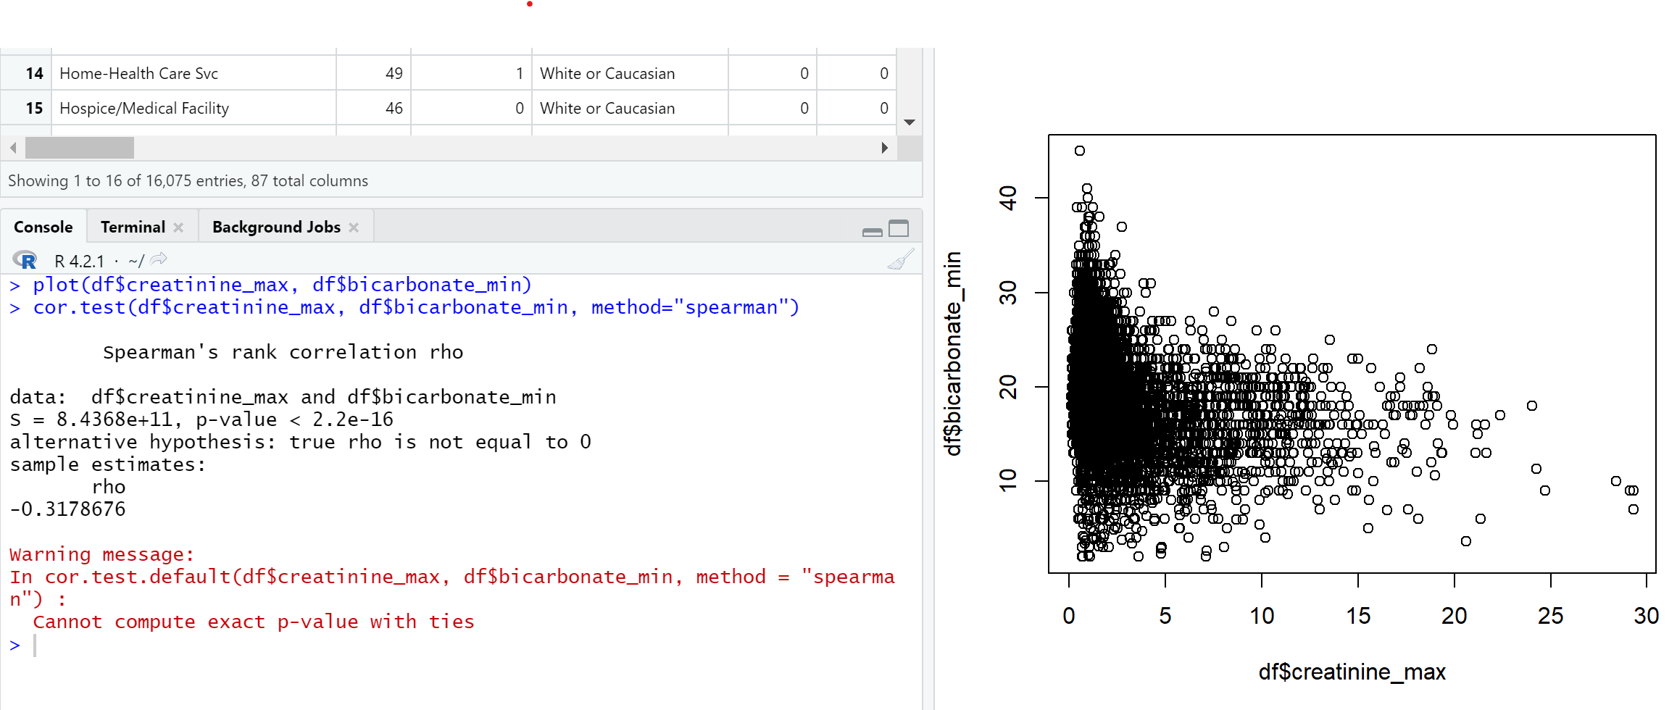

Slide 26
Exercise
Create a figure that compares the central tendency and disperision of “temperature_max” across groups defined by the died variable.
Is there a statistically significant difference between temperature_max between these two groups?

Slide 27
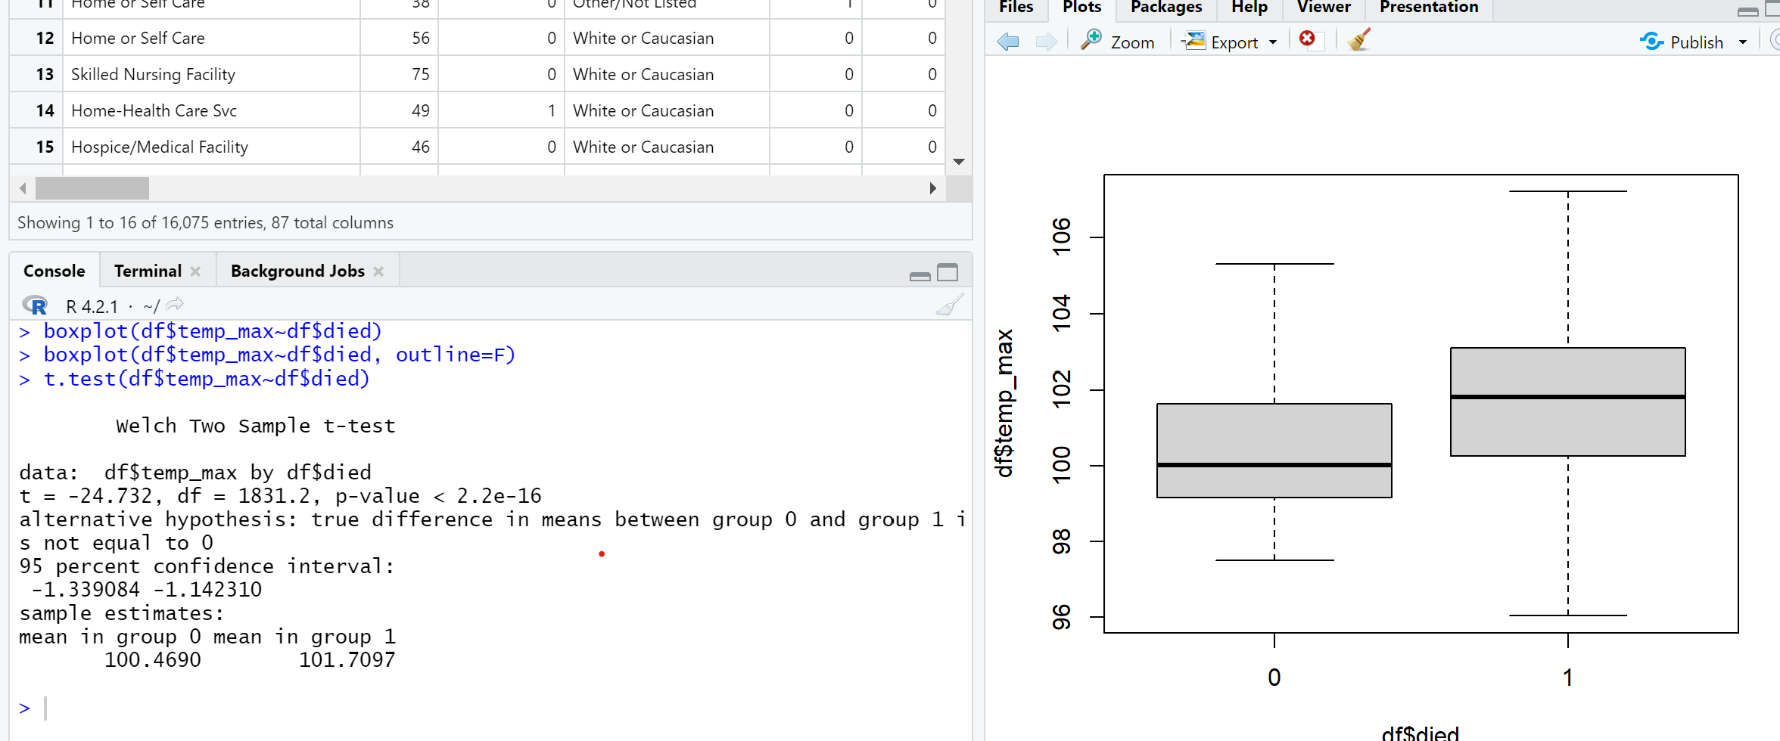
Parametric version

Slide 28
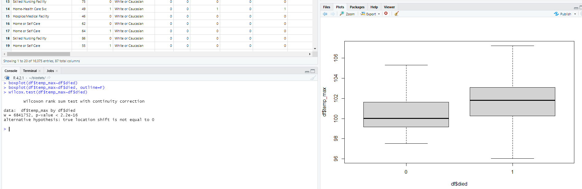
(Non-parametric version)

Slide 29
Exercise
What is the risk of death among those who identify as latino in this dataset? What about those who do not so identify?
Is there a statistically significant difference in these proportions?

Slide 30
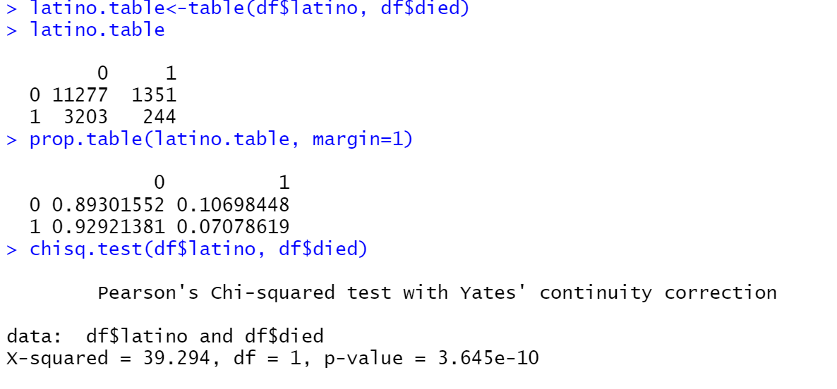

Slide 31
Exercise
Create a variable that identifies individuals who are age 65 and above or not
Among those below age 65, what is the risk of death among those who identify as latino vs. those who do not?
What about above age 65?
Is there a significant relationship between latino ethnicity and death among those below age 65?
What about among those above age 65?
Notes:
Omg this works out so nicely.

Slide 32
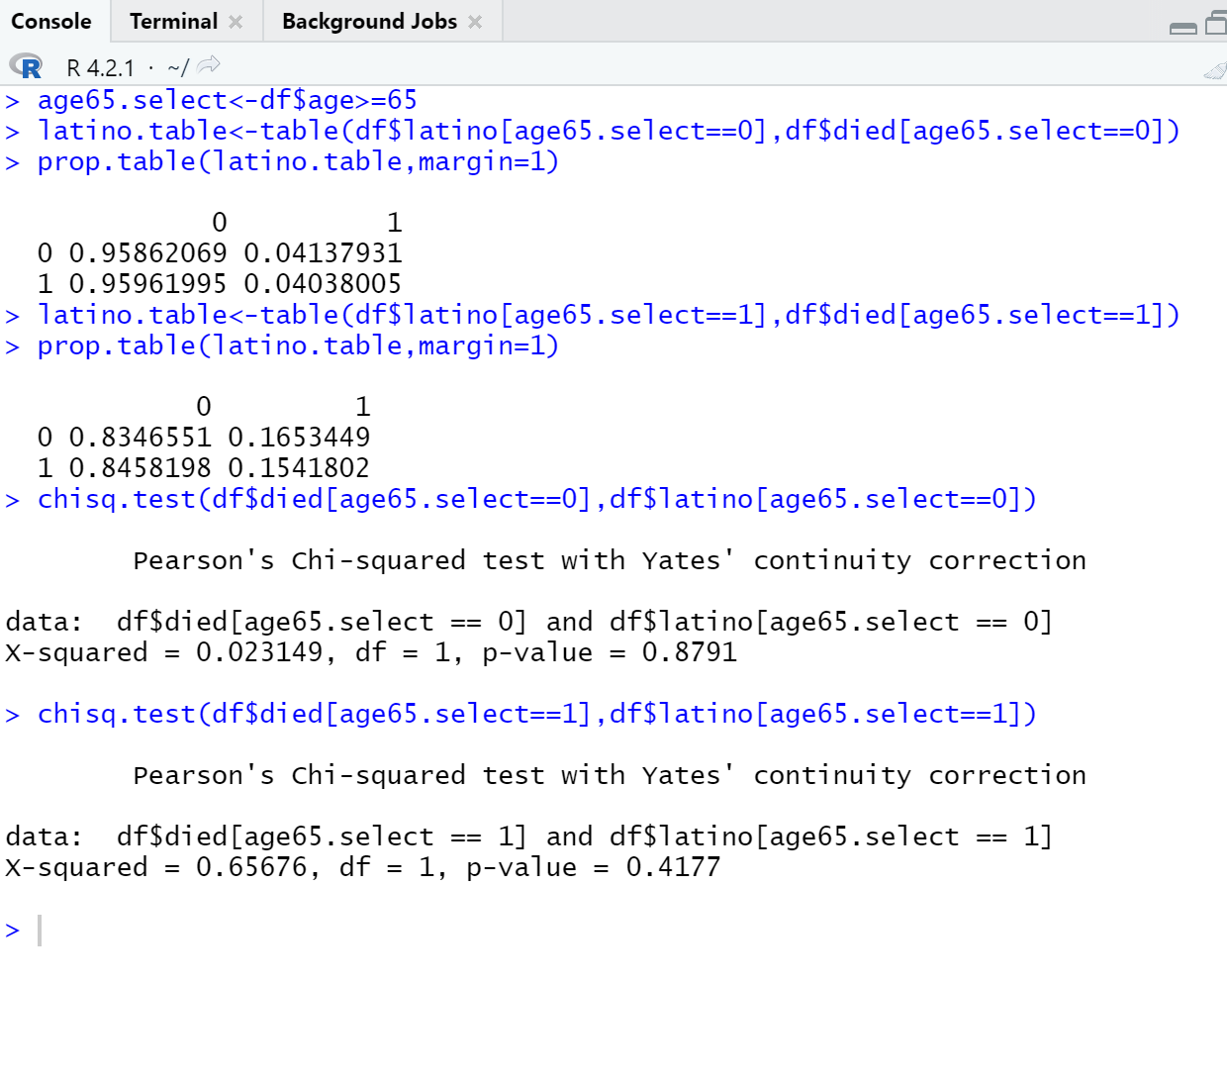

Slide 33
Fill it in!
 | died==0 | died==1 | P-value
N | 14480 | 1595 | N/a
Age (IQR) | 61 (45 – 75) | 78 (66 – 86)
Creatinine (IQR) | 1.01 (0.80 – 1.43) | 2.1 (1.3 – 3.86)
AST_max (IQR) | 48 (32 – 80) | 91 (51 – 204)
ALT_max (IQR) | 40 (23 – 78) | 51 (28 – 130)
Female Sex (%) | 7364 (50.9%) | 733 (46.0%)
Uncomplicated Diabetes
Create Table 1
:

Slide 34
Fill it in!
 | died==0 | died==1 | P-value
N | 14480 | 1595 | N/a
Age (IQR) | 61 (45 – 75) | 78 (66 – 86) | <0.001
Creatinine (IQR) | 1.01 (0.80 – 1.43) | 2.1 (1.3 – 3.86) | <0.001
AST_max (IQR) | 48 (32 – 80) | 91 (51 – 204) | <0.001
ALT_max (IQR) | 40 (23 – 78) | 51 (28 – 130) | <0.001
Female Sex (%) | 7364 (50.9%) | 733 (46.0%) | <0.001
Uncomplicated Diabetes | 2628 (18.1%) | 329 (20.6%) | 0.017
Create Table 1
:

